Slide 1

Mobile Testing Intro
www.pragmatic.bg
Lector: Dimitar Topuzov
E-mail: dtopuzov@gmail.com
LinkedIn: http://bg.linkedin.com/pub/dimitar-topuzov/18/470/833/en
Copyright © Pragmatic LLC 2018

Slide 2
Infrastructure
Learning System
URL: http://learn.pragmatic.bg/
User: your email
Pass: welcome123
Wifi
Wifi: London
Pass: knowledge123
Other Resources
https://github.com/dtopuzov

Slide 3
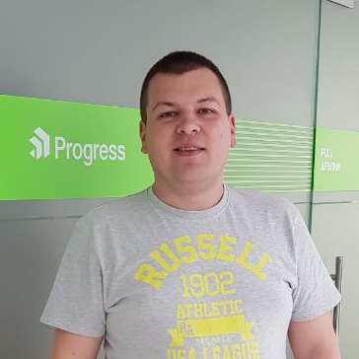
The Lecturer
Dimitar Topuzov
QA Architect @Progress
Lecturer @Pragmatic
12 years in quality engineering
Experienced in testing of
Android and iOS mobile apps
Web and Web Services
UI components for WPF (Windows desktop apps)
Testing tools (Borland’s Silk product line)
BI and Data Warehouse products
…and other things ☺

Slide 4
Today’s Agenda
The Course
Course content
Q&A
Mobile Testing Intro
Why mobile testing is important
Challenges in mobile testing
Type of mobile apps
Common issues
Emulators, simulators, real devices

Slide 5
The Course
Обект на курса
Основни теоретични и практически познания за функционално тестване на мобилни приложения
След края на курса се очаква участниците в него да умеят успешно да автоматизират Android и iOS приложения

Slide 6
The Course
Учебен материал
Курсът следва предварително обявената програма, но може да се напасне в движение спрямо група
Обратна връзка
Вие също участвате в оформянето на програмата
Прекъсвайте ме по всяко време ☺

Slide 7
The Course
Продължителност и формат на курса
Курса е вместен в 13 лекции по 3 часа
Занятията се провеждат два пъти седмично
Занятията ще са смесени - лекции и упражнения
Приблизително разпределение:
Теория – 25%
Дема от лектора – 50%
Практика от студентите – 25%
При желание може да се усигурят достатъчно количество домашни

Slide 8
The Course
Хардуерни изисквания
За упражненията и практическата част по време на занятията всеки курсист трябва да носи личен лаптоп
Препоръчително е наличието на хардуер, който позволява инсталация на Intel® HAXM
Наличието на Android телефон версия 4.3+ е бонус
Наличието на Mac Mini, Mac Book или друг Apple хардуер е бонус

Slide 9
Course Content - Must
Mobile Testing Intro
Environment setup
Testing tools and approaches
Testing in Java
Appium

Slide 10
Course Content - Extras
REST APIs and Mobile Testing
Demos (or even lecture) with .NET/Python/JS
Continues Integration with Jenkins
…and everything else you wish ☺

Slide 11

Questions

Slide 12

Questions

Slide 13
Questions
Is this the first course you visit @Pragmatic?
Do you have experience as QA
What about automation experience?
Selenium, Web Services …
What is your automation codebase?
Java, Python, .NET, JavaScript …
What about experience with mobile apps?
Manual or automation

Slide 14
Questions
What are the latest version of Android and iOS?
What is the extension of Android and iOS apps?
What is difference between Emulators/Simulators?
What is difference between Native/Hybrid Apps?
What is Xcode?
What is adb?

Slide 15
Questions
How you run automation at your company?
Do you want to know more about
CI systems and how to run tests on CI
Local build/test lab setup and maintenance

Slide 16
Mobile Testing Intro
www.pragmatic.bg

Slide 17
Why Mobile?
Imagine that now I need to:
Pay my electricity bill
Communicate with my manager/friends/family...
Buy something, but I don't have the time to go to a store
Book a hotel
What do I need to perform these activities?
Internet connectivity
A smartphone and mobile app to do the job

Slide 18
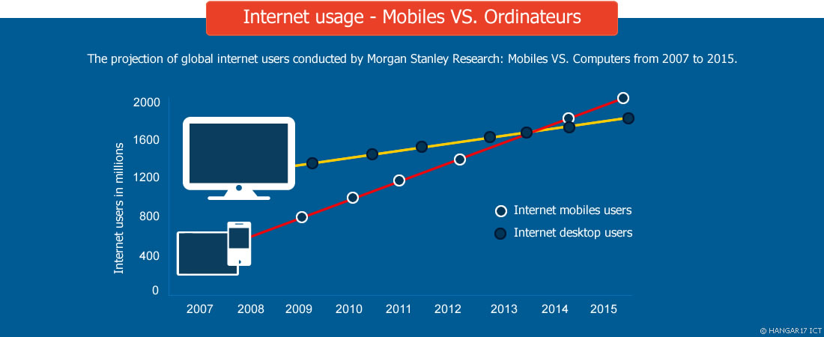
Why We Test Mobile?
The increase in usage of mobile devices

Slide 19
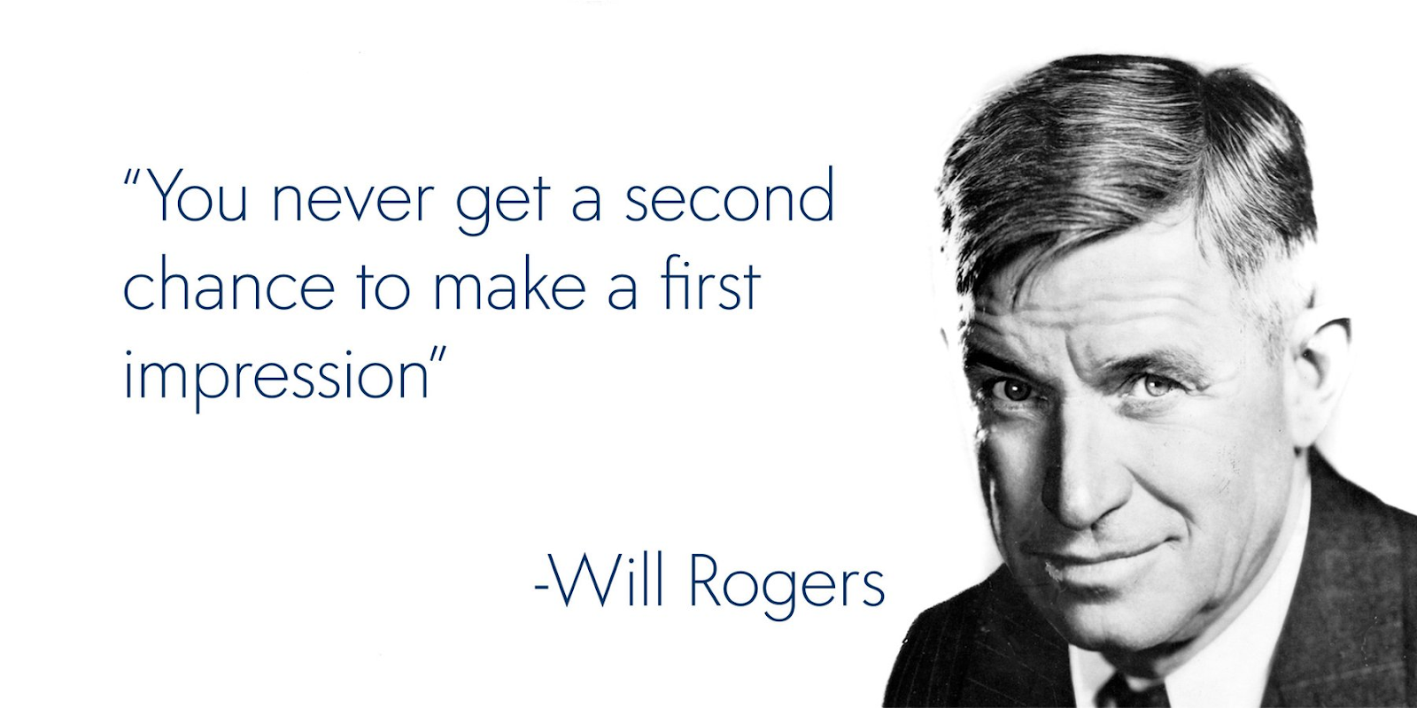
Why We Test Mobile?

Slide 20
Why We Test Mobile?
Very low tolerance for buggy mobile applications
People hate when apps crash, slow down or
According to a survey by Dimensional Research
61% of users expect mobile apps to start within 4 seconds
49% percent want responses to inputs in 2 seconds
If an app crashes, freezes, or has errors, 53% percent of users will uninstall it

Slide 21
Why We Test Mobile?
The impact of mobile application bugs
Poor user experience
Decrease in the application’s store rating
Warning: You can not delete bad comments and scores
Switching to competitor’s applications
A loss of reputation and credibility
Reduction in sales if it is a paid application

Slide 22
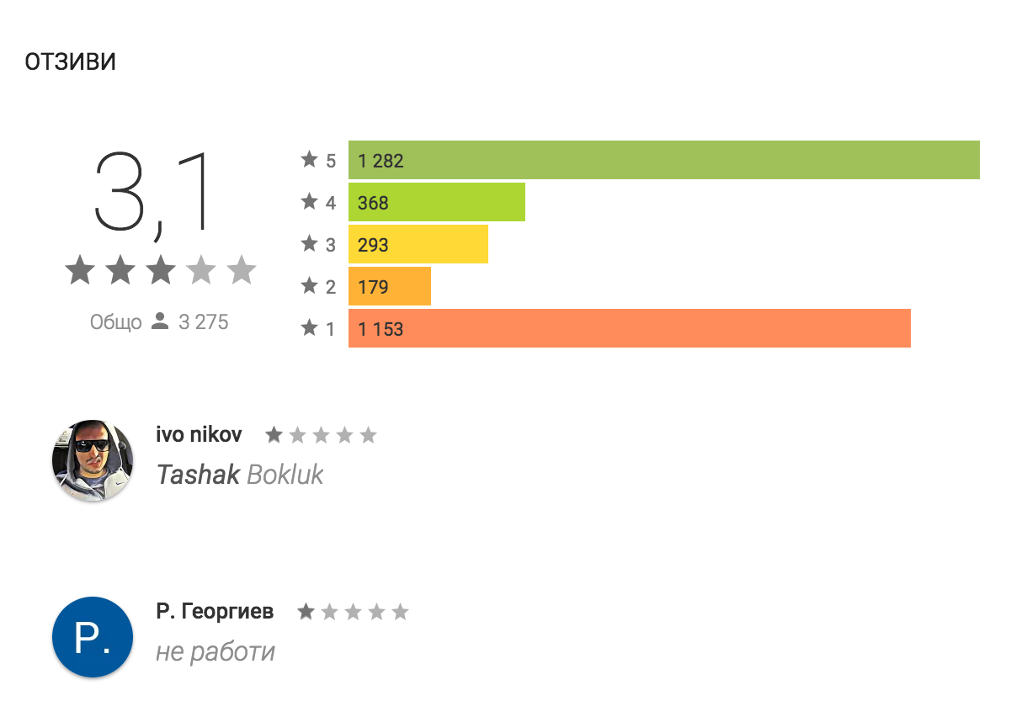
Why We Test Mobile?

Slide 23

Why We Test Mobile?

Slide 24
What We Can Test?
Functional Testing
Performance
UX/Usability
Security
Accessibility
Localization

Slide 25
Functional Testing
This is what we will do in next weeks ☺

Slide 26
Performance Testing
Loading Time
App Responsiveness
Smooth Animations
Resource Usage
Disk space, Memory, CPU, Network
Question:
How you will load test mobile app?

Slide 27
UX/Usability Testing
This is something that should not be done by QAs
Obvious issues can be found by anyone
You do need “QA Gurus with UX skills” to find that login button is not visible or too small to be clicked
Things that are “въпрос на вкус” can be evaluated only with A/B Testing
Watch “UX Usability Testing and Its Impact” by Slavy Slavov

Slide 28
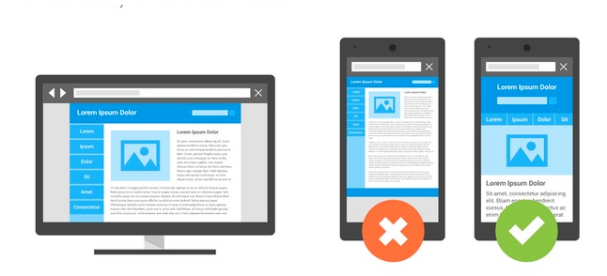
UX/Usability Testing
…и все пак, бъдете информирани!
Android has its own definitions for good UX
Do now apply iOS design to Android apps
Example: Do not put tabs at the bottom
Google recommendations for mobile web

Slide 29
Security Testing
This is something that should not be done by QAs
Usually QAs are not security experts and having QA testing security is like having a QA doing a surgery or driving a plain
Same as UX – QA can cover basic things, for more advanced security testing please get a hacker ☺

Slide 30
Accessibility Testing
There are some people with disabilities and some governments care about them
Each platform provide some Accessibility mechanism
Make sure your app accessibility is OK
Utilize some screen readers (build-in or 3rd party)

Slide 31
Localization Testing
Content localizations
Text is translated, grammar is ok
Elements holding the text are properly resized
Elements still fits on the screen at different resolutions
Visual layout is consistent with the native edition's layout (right-to-left, left-to-right)
Time zones
Verify that time zone changes are handled gracefully for your mobile application

Slide 32
Testing is not enough!
Static code analysis
Code-reviews
Unit testing
Testing API/Backend
Usually app consume some REST service
Testing your mobile apps
Functional/Performance/UX/Security/Accessibility
Analytics and Monitoring
Feature usage
Error and crash reporting

Slide 33
Challenges in Mobile Testing
www.pragmatic.bg

Slide 34
Challenges
Fragmentation of mobile devices
40+ iOS devices
18K+ Android devices
Different hardware and screen sizes
Different network types (2G, 3G, 4G or WIFI)
Different OS
Android, iOS, Windows

Slide 35
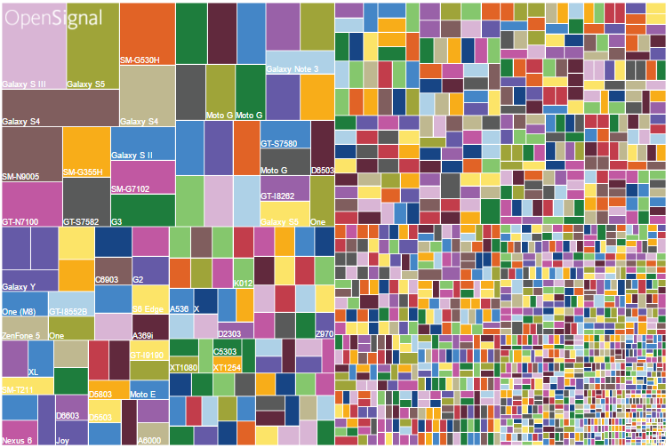
Android Fragmentation

Slide 36
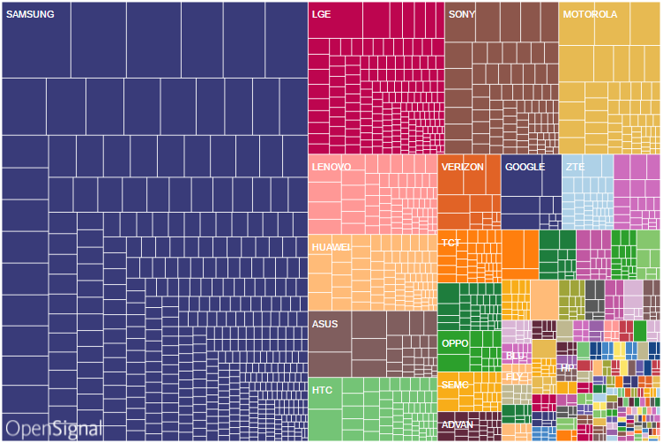
Android Fragmentation

Slide 37
Challenges
Frequency of OS releases
Android has a major release each year
Sometimes even two major releases in one year
iOS has major release each year and at least several minor releases

Slide 38
Challenges
Murphy's law applies for OS releases
Both Android and iOS release major version in almost the same time
Usually in the autumn (September)

Slide 39
Challenges
Murphy's law applies for OS releases
To test on latest iOS you need latest tooling (Xcode)
Latest Xcode may also need latest macOS
Usually Apple release 5 to 7 beta versions before official release
You need to reinstall it each time (~5GB)
After each reinstall you usually need to install iOS SDKs once again

Slide 40
Challenges
New Capabilities to test
Camera, GPS, Voice
Battery usage
Data consumption
Wearables

Slide 41
Challenges
Orientation
Various interruptions such as
incoming calls and SMS
alarm clock
low battery alerts
Gestures
touching, multi-touching, zooming, paging and navigation

Slide 42
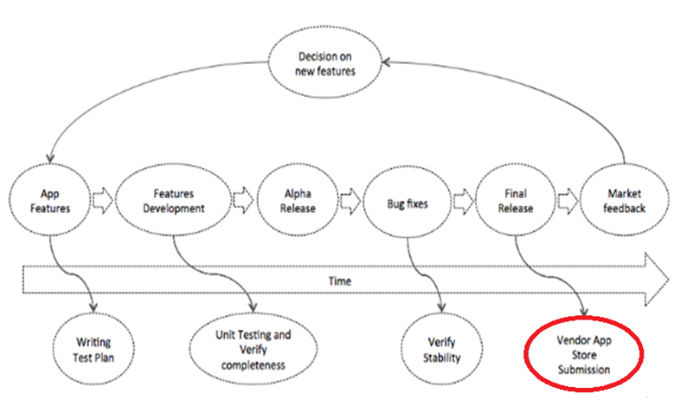
Challenges

Slide 43

Challenges
The Most Terrifying 5 Words in Testing
...by Dan Cuellar

Slide 44

Challenges
The Most Terrifying 5 Words in Testing
...by Uncle Mitko

Slide 45
…one positive ☺
Approval in store is not only headache
Approval is actually vendor doing some testing for you
No details how it is done on iOS
It should be some smoke automation + manual
On Android you app is executed on 10 physical devices with monkey tool for 5 min
Logs are great, including video.

Slide 46
Challenges
Devices
Devices are not as stable as PCs
Devices are slow
You do not test your OS, you test remote mobile OS and communication might be a challenge
iOS testing from non OSX OS is possible
But I don’t recommended it

Slide 47
Challenges
Tooling
Not mature as tooling for Web/Desktop testing
Cross-platform testing is hard (even with cross-platform tools)
Different UI controls on Android and iOS
Different accessibility models
Different limitations for Devices/Simulators

Slide 48
Challenges
Writing Tests
It is easy to create test that pass on some device
Making the test passing on all devices is the hard task
Take in to account screen size and resolution
Take in to account device speed (when wait with timeouts)
Take in to account differences in behavior caused by different OS versions

Slide 49
Challenges
Device Infrastructure
Writing tests that pass locally is the easy part
Usually things changes when you move to CI
You need to have device unlocked
Mobile device can not run apps in parallel
What will happen if device is always charging?
What will happen if the cleaning lady try to remove the dust from your phones early in thee morning while CI builds are running?

Slide 50
Challenges
Emulator/Simulator Infrastructure
Managing emulators/simulators is also hard task
Booting emulator/simulator is slow operation
If you leave them running between builds you need to
Monitor for not responding emulators/simulators
Manage app install/uninstall and cleanup user data

Slide 51
Challenges
The need of “full-stack” QA
The profile of QAs who test mobile apps is a bit different
Infrastructure is big challenge and resource taking task
Developer can develop without infrastructure, but you can not test without infrastructure
QA is the one who need something, so he should do it
Traditional DevOps might not be an option because they usually understand things like Doker, but they usually do not understand mobile world problems like Xcode, Android SDK…

Slide 52

Challenges
The Conclusion
Mobile testing is hard
Try to test on lower level
Unit Tests
API Tests

Slide 53
Common Issues
www.pragmatic.bg

Slide 54
Common Issues
Different CPU architecture
There are several popular architectures and sometimes app under test is just not including some of them
How to capture such bugs: Test all architectures that you want to support

Slide 55
Common Issues
Different vendors and custom software
Each vendor has custom software (usually for contacts, camera or other hardware) and a lot of apps does not take it in to account
Hard to capture by developer because he usually test only on one device/emulator

Slide 56
Common Issues
OS versions fragmentation
In a lot of cases app crash because system APIs are different in different version of the mobile OS
Hard to capture by developer because he usually test only on one device/emulator

Slide 57
Common Issues
Memory management
Working with images in Android world is an art
Always test memory usage specially when app uses images, and even more specially when app uses camera to take pictures
Tips: Track memory usage during functional testing

Slide 58
Common Issues
State changes might also crash the app
Changes in orientation
This is very common bug in Android
Changes in network state
Low battery mode

Slide 59
Common Issues
Run in background
Sometimes app crash or do not work correctly if you run it on a background for a while

Slide 60
Common Issues
Interruptions:
Phone call in middle of the game play
SMS and MMS
Low battery notifications
Push notifications (and all other kind of notifications)
Developers often miss out on apps behavior when interrupted.

Slide 61
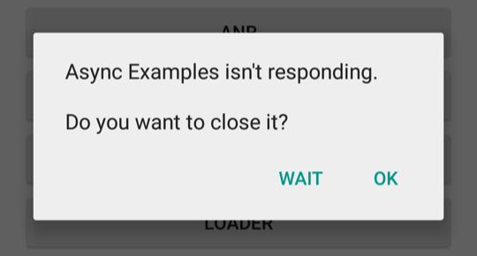
Common Issues
Blocking the main thread
The main thread has a single purpose: keeping the user interface responsive
If the main thread is blocked for a while ANR will happen

Slide 62
Common Issues
Blocking the main thread
To avoid blocking the main thread, always use worker/background threads for:
network calls
bitmap loading
image processing
database querying
SD reading / writing

Slide 63
Common Issues
UX and UI Glitches
Elements not visible on some screen sizes
It is very hard to make your app looks good on so much screen sizes
Too many questions
Long forms don't work on mobile. Small screens are tough to type. Keep your form to bare essentials.
Long Answers
Users will not write an essay on their phone. Always keep the fields short.

Slide 64
Bug or Not?
Before reporting an issue make sure it is!
A lot of QAs reported font issues after Android 5 was released, but those where not issue, it was behavior change in Android 5 - > all letters were forced to uppercase.

Slide 65
Types of Mobile Applications
www.pragmatic.bg

Slide 66
Type of Mobile Apps
Before we start testing mobile apps, first we need to be aware of following:
What type of mobile apps we have
What technologies are used and how they work
How developers write code and build apps
How and where I can run those apps
What are the features of the app
…in other word: First we need some domain knowledge

Slide 67
Type of Mobile Apps
Native Apps
Hybrid Apps
Mobile Web

Slide 68
Native Apps
Example
Facebook
Benefits
Can take full advantage of all the device features
Camera, GPS, Accelerometer, Compass, Contacts, and so on.
Can use the device’s notification system
Can work offline

Slide 69
Native Apps
Benefits
Offer the best user experience
Performance, Animations, Native UX.
Available at application stores
Installed on the device and accessed through icons on the device home screen

Slide 70
Native Apps
Downside
Usually developed as separate app for each platform
Java for Android, Objective C or Swift for iOS
You need both Android(Java) and iOS(Swift) experts
Usually most expensive for implementation
Code reuse between platforms is hard, result is:
Android and iOS Apps with different experience, features and bugs

Slide 71
Native Apps – Future
Cross-platform native mobile development
Single codebase for both Android and iOS
Usually reuse web skills
Sometimes provide options to reuse code between web and mobile apps

Slide 72
Native Apps – Future
Vendors/Tools/Frameworks:
Xamarin
Use .NET to create cross-platform native apps
Developed by Microsoft
ReactNative
Use React, developed by Facebook
NativeScript
Use JS/TS/Angular/Vue, developed by Progress

Slide 73
Mobile Web
Benefits
Easy and Cheap Development
Developing responsive design and restructuring the content to be properly displayed on a smaller screen
Easy update
Software is hosted on your servers, not in store
No installation required

Slide 74
Mobile Web
Downside
Mobile websites cannot use most of device features
For example, access to the file system and local resources
No app’s icon on home screen
The website needs to be opened in a web browser only
Not available on the App Store and Google Play

Slide 75
Hybrid Apps
Hybrid apps are part native apps, part web apps
Live in an app store
Can take advantage of the many device features
Rely on HTML being rendered in a embedded browser
Allow cross-platform development with Web technologies
HTML, CSS, Java Script

Slide 76
Hybrid Apps
Significantly reduce development costs
Performance is not so good as native apps
User experience is not as good as native apps
It is hard to style web to look as native
Additional maintenance when new mobile OS looks different

Slide 77
Type of Mobile Apps
Why it is important for you to know what type of apps you will test?
Different types can be tested with different tools
Different types of apps require different DevTools Ecosystem
This might affect tools you use for testing
If you develop iOS native app most likely all developers use macOS and Swift, most likely it is not good idea QAs to use Windows and .NET based tools
Different types of apps has different type of bugs

Slide 78
Type of Mobile Apps
Why it is important for you to know what type of apps you will test?
If app under test interact with other native mobile UI (like push notifications) most likely you need a tool that can do testing outside your app
There are a tools that can automate only app under test and nothing else on the screen (we will talk later)

Slide 79
Type of Mobile Apps
Why it is important for you to know what type of apps you will test?
Different types of apps can affect testing infrastructure
For some apps it is highly recommended to test mostly on real devices, for other apps you can capture 99% of issues on Emulators and Simulators (we will talk later)

Slide 80
Type of Mobile Apps
Why it is important for you to know what type of apps you will test?
Каквото и да тестваш, трябва да знаеш как работи от вътре!
Напомнете ми да ви разкажа нещо за карането на картинг ☺
Ако тествате iOS, първо се научете да работите с macOS и да пишете shell scripts
…и като цяло преди да тествате приложение, пробвайте се да си го билднете, да пипнете в кода, да дебъгвате

Slide 81
Emulators, Simulators and Real Devices
www.pragmatic.bg

Slide 82
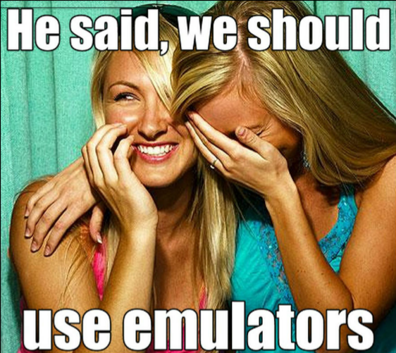
Emulators vs. Devices

Slide 83
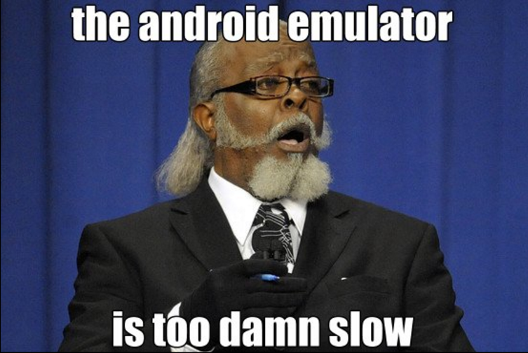
Emulators vs. Devices

Slide 84

Android Emulators

Slide 85
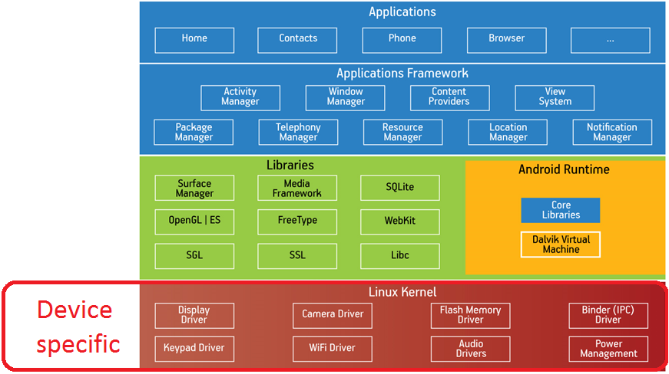
Android System

Slide 86
Android Emulator
Android emulator run virtual machine (arm or x86)
…with all the software stack on top of it
Linux kernel, Android system image, etc
Actually
Emulator is just another android device
System images are almost identical (only different drivers)
Hardware is emulated

Slide 87
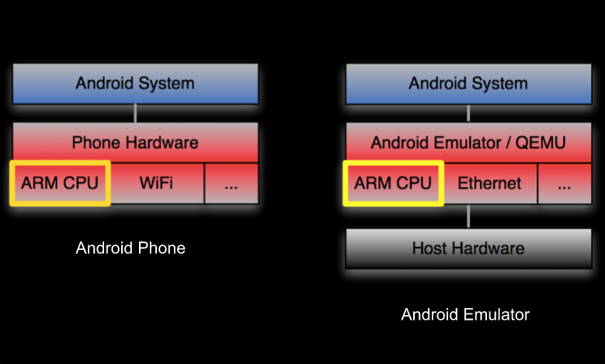
Under the Hood

Slide 88
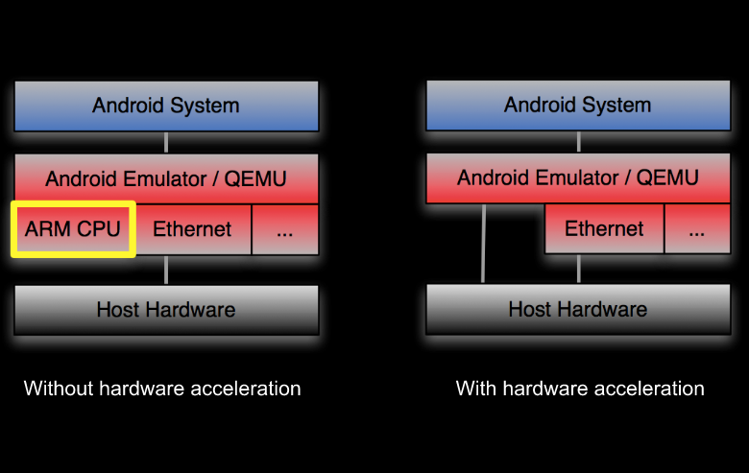
Accelerated Emulator

Slide 89
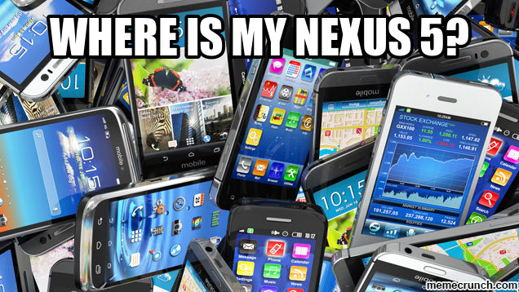
Emulator Benefits
Any device on you fingertips

Slide 90
Emulator Benefits
Faster compared to real device (If accelerated)
Easy and cheap way to catch bugs related to
Different OS versions
Different resolutions
Low memory

Slide 91
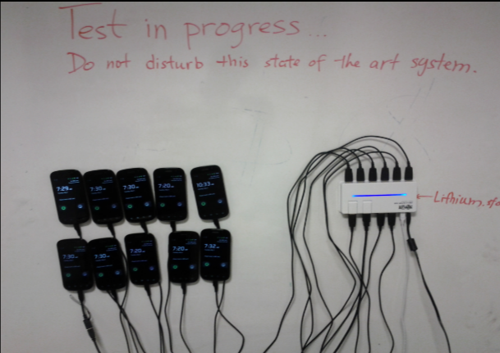
Emulator Benefits
Helps you to simplify device infrastructure

Slide 92
Emulator Disadvantages
0% of real users use emulators
Hardware is different
Different vendors ship different software
Emulators are not a good option for testing
Performance
Sensor related things (camera, location, accelerometer)
File level access operations and storage

Slide 93
iOS Simulator
iOS Simulator simulate iOS, watchOS, and tvOS
Program that runs on macOS and simulate how app will be rendered on different device type and OS version
Simply emulates all the iOS APIs on your host CPU
The project is recompiled for architecture of your Mac, not architecture of your iOS phone

Slide 94
iOS Simulator
Benefits
It is faster compared to android emulators
UI is exactly the same as on real apple devices
With Xcode 9+ you can run multiple at the same time

Slide 95
iOS Simulator
Disadvantages
Can not find bugs related to
CPU architecture
Memory constraints
Disk space

Slide 96
Screen Size and Density
www.pragmatic.bg

Slide 97
Screen Size
Actual physical size, measured as the screen's diagonal.
For simplicity, Android groups all actual screen sizes into four generalized sizes
Small
Normal
Large
Extra-large

Slide 98
Screen Density
The quantity of pixels within a physical area of the screen
Usually referred to as dpi (dots per inch)
For example, a "low" density screen has fewer pixels within a given physical area, compared to a "normal" or "high" density screen
For simplicity, Android groups all actual screen densities into six generalized densities:
low, medium, high, extra-high, extra-extra-high, and extra-extra-extra-high

Slide 99
Resolution
The total number of physical pixels on a screen
When adding support for multiple screens, applications do not work directly with resolution
Applications should be concerned only with screen size and density, as specified by the generalized size and density groups

Slide 100
Density-independent pixel (dp)
A virtual pixel unit that you should use when defining UI layout, to express layout dimensions or position in a density-independent way
The density-independent pixel is equivalent to one physical pixel on a 160 dpi screen, which is the baseline density assumed by the system for a "medium" density screen.
The conversion of dp units to screen pixels is simple:
px = dp * (dpi / 160).
For example, on a 240 dpi screen, 1 dp equals 1.5 physical pixels. You should always use dp units when defining your application's UI, to ensure proper display of your UI on screens with different densities.

Slide 101
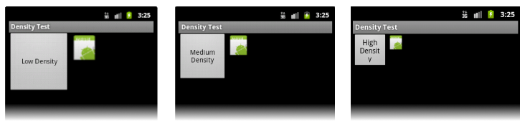
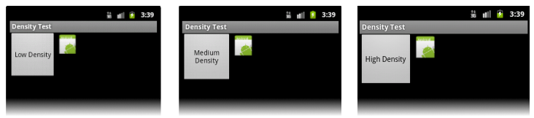
Density-independent pixel (dp)
When you develop in pixels:
When you develop in independent pixels:

Slide 102
Lessons Learned
www.pragmatic.bg

Slide 103
Lessons Learned
Avoid mobile testing :)
It is hard, it is slow and it is flaky
Forget about Windows (if possible)
iOS usually can be tested only from OSX
A lot of tools are not available for Windows
Get powerful hardware
Execution time (specially for emulators) improves a lot with SSD and fast CPU/RAM
Run some (not all) tests on real devices
Remember – 0% of real users use emulators

Slide 104

Lessons Learned
Learn UNIX

Slide 105
How I Can Learn More
Practice a lot (and regularly)
Getting your hands dirty is the best way to learn something
Read official docs, GitHub issues and commits
Follow great people on Twitter and GitHub
Authors of Selenium/Appium, Emanuil Slavov and so on
Watch videos from GTAC, Appium and Selenium Conferences

Slide 106
How NOT to Learn
Do NOT trust tutorials and articles:
Where someone talk for “load testing mobile app”
Which explain something for iOS version < 9
Examples:
http://www.tutorialspoint.com/mobile_testing
http://www.guru99.com/mobile-testing.html
https://fossbytes.com/5-open-source-mobile-test-automation-tools/
Do NOT learn only by reading
Always try and evaluate the content
Practice a lot!

Slide 107
Certifications
ASTQB can certify you as mobile tester
Materials to be attached on http://learn.pragmatic.bg/

Slide 108
Questions

